Slide 1
Safe Artificial Intelligence and Formal Methods
Pașcan Adrian - 18/11/2021, FM Paper Presentation

Slide 2
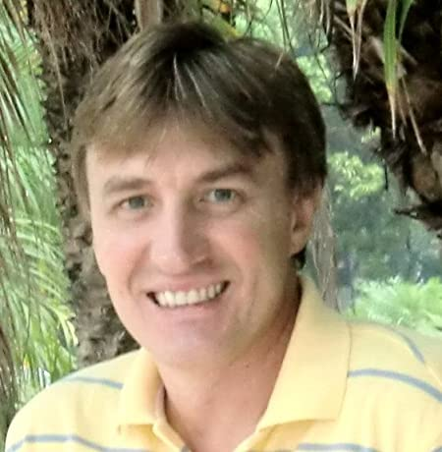
About
position paper
Emil Vassev
International Symposium of Leveraging Applications of Formal Methods, 2016
https://ulir.ul.ie/bitstream/handle/10344/5407/Vassev_2016_safe.pdf?sequence=2

Slide 3
Agenda
Subject + Motivation
Paper - section by section
Conclusion

Slide 4
Subject & Motivation
Use of formal methods for AI safety, both in life and technology.
In the near future, AI will go beyond the original human intensions, implying a level of artificial awareness. This, in turn, requires knowledge representation as a formal specification.

Slide 5
Artificial Intelligence and Safety
2 “cultures”
Build a functional system, and try to make it safe near the end of the process
Build a system designed “from the ground up” with safety in mind
Open-world modeling using formal methods
AI is limited by system functionality

Slide 6
Artificial Intelligence and Safety
NASA & ESA systems
Safety-critical systems
Ensure predictable system performance under normal and abnormal conditions
Imply self-adaptive behaviour

Slide 7
Artificial Intelligence and Safety
NASA & ESA systems (contd.)
4-stage derivation of safety-related AI requirements:
Hazard identification
Hazard analysis
Identifying safety capabilities
Requirements derivation
- what accidents?
- how can it get to an accident?
- for what goals is it safe?
- how to prevent/mitigate accidents?

Slide 8
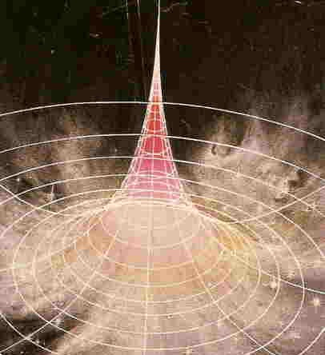
AI and Technological Singularity
Singularity = an asymptote-like situation where normal rules no longer apply
How does AI decide when are hazards not hazards anymore?
Direct & indirect Damage

Slide 9
No System Can Be 100% Safe
Good requirements formalisation depends on:
The analytical skills of the requirements engineers
Proper use of the formal methods in hand
Formal methods:
Do no eliminate testing, but complement it
Help automatic test case generation through formal specifications
Add on safety, do not guarantee it

Slide 10
No System Can Be 100% Safe
(contd.)
Quantitative measure of safety imposed by formal methods
Early detection of safety flaws
High quality requirements improve their design & implementation
Help derivation and generation of efficient test cases
=> System with up to 99% safety guarantee

Slide 11
What can be Formalized?
Contemporary formal verification techniques (e.g. model checking) rely on state-transition model
Formalize “nothing bad will happen to the system”
Check safety and liveness properties
Human behaviour and principles cannot be formalized
Verification tools for fuzzy control systems (“degrees of truth”) are not efficient due to the huge state-explosion problem

Slide 12
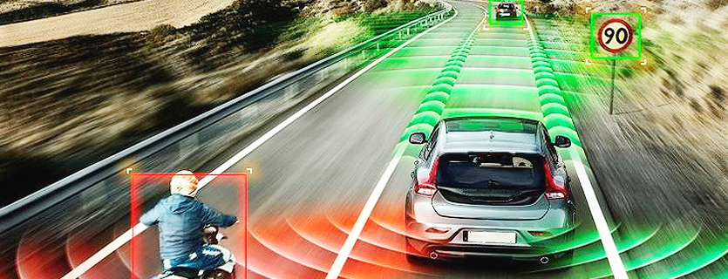
Safe Self-driving Car Example
non-deterministic and open-world environment

Slide 13
Safe Self-driving Car Example
Context | Self-adaptive behaviour
School | decrease the speed down to 20 mph
Severe weather conditions | low speed, turn lights on, turn wipers on
Pedestrians | turn off the engine when the brake system is malfunctioning and the car is getting in close proximity to pedestrians

Slide 14
Deductive Guarantees & Probabilistic Guarantees
Deductive guarantees
Prove simple safety properties
Prone to resolution refutation
2 sets of premises may lead to different results

Slide 15
Deductive Guarantees & Probabilistic Guarantees
Probabilistic guarantees
A complete proof is not necessary
Check more complex properties with some degree of uncertainty

Slide 16
Deductive Guarantees & Probabilistic Guarantees
Deductive VS Probabilistic guarantees (DG VS PG)
PG bring less confidence than DG
PG deal with more complex properties
PG may bring some extra confidence to safety properties that cannot be handled otherwise

Slide 17
Deductive Guarantees & Probabilistic Guarantees
Abstraction
The most efficient solution to the state-explosion problem
State space is reduced by aggregating state transitions into coarser-grained state transitions
The granularity of the system may be reduced to a point where it no longer adequately represents that system

Slide 18
Deductive Guarantees & Probabilistic Guarantees
Global Safety Invariants
Goal invariants
Behaviour invariants
Interaction invariants
Resource invariants

Slide 19
Improving our Current Verification Toolset
Model checking
Properties = temporal logic
System formalisation = state machine
Check finite, yet small spaces
Larger state spaces on symbolic + probabilistic model checking

Slide 20
Improving our Current Verification Toolset
(contd.)
Use stabilization science and stability analysis
Efficiently test system behaviour under simulated conditions using:
Code generation & analysis techniques for efficient test-case generation
Automatic test case generation
Explore multiple state spaces simultaneously by parallelizing simulations through high-performance computing

Slide 21
Conclusion
Uncertainty as part of the development process
Deductive and probabilistic guarantees may help cover a wide range of uncertainty
Contemporary formal verification toolset is not powerful enough to guarantee safety
New and enhanced toolset includes better automated reasoning and model checking + new verification techniques based on stabilization science, test-case generation and simulation, parallelized using high-performance computing

Slide 22

Thank you!

